Slide 1
Unit 3: Periodic Table
Chapter 5

Slide 2
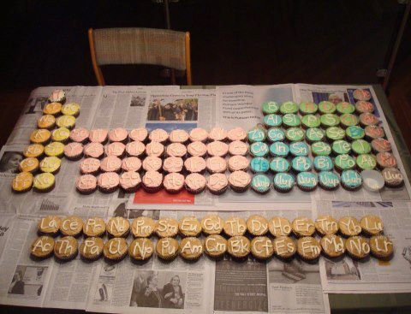

Slide 3
Section 5.1 Review
Mendeleev:
grouped elements by similar properties, arranged by increasing atomic mass, left spaces for “unknown” elements
Moseley:
arranged by nuclear charge (# of protons)
Modern PT:
arranged by atomic # and similar properties in groups
Periodicity: regular repeating pattern of properties across a period in the PT

Slide 4
5.2
Periods of PT determined by electron configuration (# of electrons occupying sublevels being filled)
Location of element on PT can be determined by electron configuration
PT divided into 4 blocks: s, p, d, f
Period | # of elements in period | Sublevels in order of filling
1 | 2 | 1s
2 | 8 | 2s2p
3 | 8 | 3s3p
4 | 18 | 4s3d4p

Slide 5
Groups of elements
S-block and p-block make up the main group elements (representative elements)
S-block: alkali metals, alkaline earth metals, hydrogen, helium
Group 1 Alkali metals:
silvery appearance, soft, extremely reactive, MP decreases down the group (Li has higher MP than Cs)
Group 2 Alkaline earth metals:
contain pair of electrons in s sublevel, harder, denser, stronger than alkali metals, very reactive
Hydrogen:
does not share properties with alkali metals, gas at room temp, flammable (exists in nature as a diatomic molecule, H₂)
Helium:
located in group 18, chemically stable, nonreactive

Slide 6
P-block: groups 13-18,includes metals, nonmetals, and metalloids (not including Helium)
Properties vary across p-block
Group 17: halogens
Most reactive nonmetals, react with metals to form salts, F and Cl are gases, Br liquid, I and At solids (F, Br, Cl, I exist as diatomic molecules: F₂, Br₂, Cl₂, I₂)
Group 18: noble gases
Nonreactive, inert gases
Metalloids:
brittle solids, some conductivity of electricity but not as much as metals
P-block metals:
harder and denser than s-block, softer and less dense than d-block, stable in presence of air
Other diatomic molecules in p-block include N and O (N₂ and O₂) both are gases

Slide 7
D-block: groups 3-12
Transition elements
Less reactive than s-block elements
Mercury is the only liquid metal at room temp
Some are nearly non reactive
Many do not form compounds
Exist as free elements in nature
Pd, Pt, and Au are some of least reactive transition metals

Slide 8
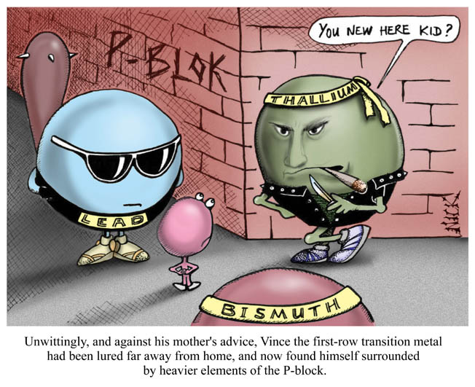
http://www.thetutorstudio.com/img/pblock.jpg

Slide 9
F-block: lanthanides and actinides (inner transition metals)
Wedged between groups 3 and 4 in transition metals
Lanthanides:
located in period 6
shiny metals
similar reactivity to group 2
Actinides:
Located in period 7
all radioactive,
Th –Np naturally occurring, others laboratory created

Slide 10
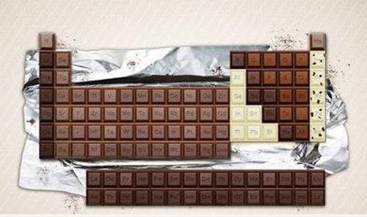

Slide 11
Periodic properties 5.3
trends/ properties: main group elements (s and p block)
Atomic radii: radius of atom, indicates volume
Measured either from nucleus to outermost electron level OR distance between two identical nuclei when bonded
Period trend: atomic radii (size) decreases across a period from group 1 to group 18
Li is larger than Be which is larger than B…. Smallest is Ne in period 2
Group trend: atomic radii (size) increases down a group from period 1 to period 7
Li is smaller than Na which is smaller than K which is smaller than Rb… Largest is Fr in group 1

Slide 12
Coloring time!
Label/ color code your non Pacific U/ navy periodic table to include:
States of matter
Group names (alkali metals, etc) Use your note page to help you
s, p, d, f groups
Diatomic molecules
THIS IS A TOOL FOR YOU TO HELP YOU WHEN STUDYING FOR YOUR TEST

