Slide 1
Significance of a Chemical Formula
A chemical formula indicates the relative number of atoms of each kind in a chemical compound.
For a molecular compound, the chemical formula reveals the number of atoms of each element contained in a single molecule of the compound.
example: octane — C₈H₁₈
The subscript after the C indicates that there are 8 carbon atoms in the molecule.
The subscript after the H indicates that there are 18 hydrogen atoms in the molecule.

Slide 2
Significance of a Chemical Formula, continued
The chemical formula for an ionic compound represents one formula unit—the simplest ratio of the compound’s positive ions (cations) and its negative ions (anions).
example: aluminum sulfate — Al₂(SO₄)₃
Parentheses surround the polyatomic ion to identify it as a unit. The subscript 3 refers to the unit.
Note also that there is no subscript for sulfur: when there is no subscript next to an atom, the subscript is understood to be 1.

Slide 3
Monatomic Ions
Many main-group elements can lose or gain electrons to form ions.
Ions formed form a single atom are known as monatomic ions.
example: To gain a noble-gas electron configuration, nitrogen gains three electrons to form N^{3–} ions.
Some main-group elements tend to form covalent bonds instead of forming ions.
examples: carbon and silicon

Slide 4
Monatomic Ions, continued
Naming Monatomic Ions
Monatomic cations are identified simply by the element’s name.
examples:
K⁺ is called the potassium cation
Mg²⁺ is called the magnesium cation
For monatomic anions, the ending of the element’s name is dropped, and the ending -ide is added to the root name.
examples:
F– is called the fluoride anion
N^{3–} is called the nitride anion

Slide 5
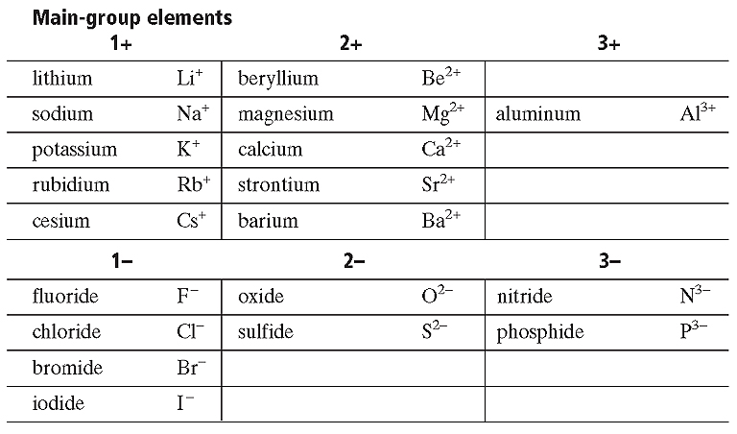
Common Monatomic Ions
Section 1 Chemical Names and Formulas
Chapter 7

Slide 6
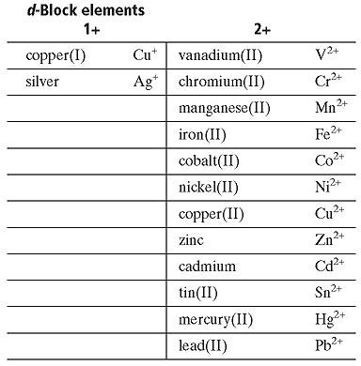
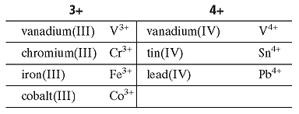
Common Monatomic Ions

Slide 7
Binary Ionic Compounds
Section 1 Chemical Names and Formulas
Chapter 7
Compounds composed of two elements are known as binary compounds.
In a binary ionic compound, the total numbers of positive charges and negative charges must be equal.
The formula for a binary ionic compound can be written given the identities of the compound’s ions.
example: magnesium bromide
Ions combined: Mg²⁺, Br–, Br–
Chemical formula: MgBr₂

Slide 8
Binary Ionic Compounds, continued
A general rule to use when determining the formula for a binary ionic compound is “crossing over” to balance charges between ions.
example: aluminum oxide
1) Write the symbols for the ions.
Al³⁺ O^{2–}
2) Cross over the charges by using the absolute value of each ion’s charge as the subscript for the other ion.

Slide 9
Binary Ionic Compounds, continued
Section 1 Chemical Names and Formulas
Chapter 7
example: aluminum oxide, continued
3) Check the combined positive and negative charges to see if they are equal.
(2 × 3+) + (3 × 2–) = 0
The correct formula is Al₂O₃

Slide 10
Writing the Formula of an Ionic Compound

Slide 11
Naming Binary Ionic Compounds
Section 1 Chemical Names and Formulas
Chapter 7
The nomenclature, or naming system, or binary ionic compounds involves combining the names of the compound’s positive and negative ions.
The name of the cation is given first, followed by the name of the anion:
example: Al₂O₃ — aluminum oxide
For most simple ionic compounds, the ratio of the ions is not given in the compound’s name, because it is understood based on the relative charges of the compound’s ions.

Slide 12
Naming Binary Ionic Compounds, continued
Section 1 Chemical Names and Formulas
Chapter 7
Sample Problem A
Write the formulas for the binary ionic compounds formed between the following elements:
a. zinc and iodine
b. zinc and sulfur

Slide 13
Naming Binary Ionic Compounds, continued
Section 1 Chemical Names and Formulas
Chapter 7
Sample Problem A Solution
Write the symbols for the ions side by side. Write the cation first.
a. Zn²⁺ I⁻
b. Zn²⁺ S²⁻
Cross over the charges to give subscripts.
a.
b.

Slide 14
Naming Binary Ionic Compounds, continued
Section 1 Chemical Names and Formulas
Chapter 7
Sample Problem A Solution, continued
Check the subscripts and divide them by their largest common factor to give the smallest possible whole-number ratio of ions.
a. The subscripts give equal total charges of 1 × 2+ = 2+ and 2 × 1− = 2−.
The largest common factor of the subscripts is 1.
The smallest possible whole-number ratio of ions in the compound is 1:2.
The formula is
ZnI₂.

Slide 15
Naming Binary Ionic Compounds, continued
Section 1 Chemical Names and Formulas
Chapter 7
Sample Problem A Solution, continued
b. The subscripts give equal total charges of 2 × 2+ = 4+ and 2 × 2− = 4−.
The largest common factor of the subscripts is 2.
The smallest whole-number ratio of ions in the compound is 1:1.
The formula is
ZnS.

Slide 16
Naming Binary Ionic Compounds, continued
Section 1 Chemical Names and Formulas
Chapter 7
The Stock System of Nomenclature
Some elements such as iron, form two or more cations with different charges.
To distinguish the ions formed by such elements, scientists use the Stock system of nomenclature.
The system uses a Roman numeral to indicate an ion’s charge.
examples: Fe²⁺ iron(II)
Fe³⁺ iron(III)

Slide 17
Naming Binary Ionic Compounds, continued The Stock System of Nomenclature, continued
Section 1 Chemical Names and Formulas
Chapter 7
Sample Problem B
Write the formula and give the name for the compound formed by the ions Cr³⁺ and F–.

Slide 18
Naming Binary Ionic Compounds, continued The Stock System of Nomenclature, continued
Section 1 Chemical Names and Formulas
Chapter 7
Sample Problem B Solution
Write the symbols for the ions side by side. Write the cation first.
Cr³⁺ F⁻
Cross over the charges to give subscripts.

Slide 19
Naming Binary Ionic Compounds, continued The Stock System of Nomenclature, continued
Section 1 Chemical Names and Formulas
Chapter 7
Sample Problem B Solution, continued
The subscripts give charges of 1 × 3+ = 3+ and 3 × 1− = 3−.
The largest common factor of the subscripts is 1, so the smallest whole number ratio of the ions is 1:3.
The formula is
CrF₃.

Slide 20
Naming Binary Ionic Compounds, continued The Stock System of Nomenclature, continued
Section 1 Chemical Names and Formulas
Chapter 7
Sample Problem B Solution, continued
Chromium forms more than one ion, so the name of the 3+ chromium ion must be followed by a Roman numeral indicating its charge.
The compound’s name is
chromium(III) fluoride.

Slide 21
Naming Binary Ionic Compounds, continued Compounds Containing Polyatomic Ions
Section 1 Chemical Names and Formulas
Chapter 7
Many common polyatomic ions are oxyanions— polyatomic ions that contain oxygen.
Some elements can combine with oxygen to form more than one type of oxyanion.
example: nitrogen can form or .
The name of the ion with the greater number of oxygen atoms ends in -ate. The name of the ion with the smaller number of oxygen atoms ends in -ite.
nitrate nitrite

Slide 22
Naming Binary Ionic Compounds, continued Compounds Containing Polyatomic Ions, continued
Section 1 Chemical Names and Formulas
Chapter 7
Some elements can form more than two types of oxyanions.
example: chlorine can form
In this case, an anion that has one fewer oxygen atom than the -ite anion has is given the prefix hypo-.
An anion that has one more oxygen atom than the -ate anion has is given the prefix per-.
hypochlorite chlorite chlorate perchlorate

Slide 23
Polyatomic Ions
Section 1 Chemical Names and Formulas
Chapter 7

Slide 24
Naming Compounds with Polyatomic Ions
Section 1 Chemical Names and Formulas
Chapter 7

Slide 25
Understanding Formulas for Polyatomic Ionic Compounds

Slide 26
Naming Binary Ionic Compounds, continued Compounds Containing Polyatomic Ions, continued
Section 1 Chemical Names and Formulas
Chapter 7
Sample Problem C
Write the formula for tin(IV) sulfate.

Slide 27
Naming Binary Ionic Compounds, continued Compounds Containing Polyatomic Ions, continued
Section 1 Chemical Names and Formulas
Chapter 7
Cross over the charges to give subscripts. Add parentheses around the polyatomic ion if necessary.
Cross over the charges to give subscripts. Add parentheses around the polyatomic ion if necessary.

Slide 28
Naming Binary Ionic Compounds, continued Compounds Containing Polyatomic Ions, continued
Section 1 Chemical Names and Formulas
Chapter 7
Sample Problem C Solution, continued
The total positive charge is 2 × 4+ = 8+.
The total negative charge is 4 × 2− = 8−.
The largest common factor of the subscripts is 2, so the smallest whole-number ratio of ions in the compound is 1:2.
The correct formula is therefore
Sn(SO₄)₂.

Slide 29
Naming Binary Molecular Compounds
Section 1 Chemical Names and Formulas
Chapter 7
Unlike ionic compounds, molecular compounds are composed of individual covalently bonded units, or molecules.
As with ionic compounds, there is also a Stock system for naming molecular compounds.
The old system of naming molecular compounds is based on the use of prefixes.
examples: CCl₄ — carbon tetrachloride (tetra- = 4) CO — carbon monoxide (mon- = 1) CO₂ — carbon dioxide (di- = 2)

Slide 30
Prefixes for Naming Covalent Compounds

Slide 31
Naming Binary Molecular Compounds, continued
Section 1 Chemical Names and Formulas
Chapter 7
Sample Problem D
a. Give the name for As₂O₅.
b. Write the formula for oxygen difluoride.

Slide 32
Naming Binary Molecular Compounds, continued
Section 1 Chemical Names and Formulas
Chapter 7
Sample Problem D Solution
a. A molecule of the compound contains two arsenic atoms, so the first word in the name is diarsenic.
The five oxygen atoms are indicated by adding the prefix pent- to the word oxide.
The complete name is
diarsenic pentoxide.

Slide 33
Naming Binary Molecular Compounds, continued
Section 1 Chemical Names and Formulas
Chapter 7
Sample Problem D Solution, continued
b. Oxygen is first in the name because it is less electronegative than fluorine.
Because there is no prefix, there must be only one oxygen atom.
The prefix di- in difluoride shows that there are two fluorine atoms in the molecule.
The formula is
OF₂.

Slide 34
Covalent-Network Compounds
Section 1 Chemical Names and Formulas
Chapter 7
Some covalent compounds do not consist of individual molecules.
Instead, each atom is joined to all its neighbors in a covalently bonded, three-dimensional network.
Subscripts in a formula for covalent-network compound indicate smallest whole-number ratios of the atoms in the compound.
examples: SiC, silicon carbide SiO₂, silicon dioxide Si₃N₄, trisilicon tetranitride.

Slide 35
Acids and Salts
Section 1 Chemical Names and Formulas
Chapter 7
An acid is a certain type of molecular compound. Most acids used in the laboratory are either binary acids or oxyacids.
Binary acids are acids that consist of two elements, usually hydrogen and a halogen.
Oxyacids are acids that contain hydrogen, oxygen, and a third element (usually a nonmetal).

Slide 36
Acids and Salts, continued
Section 1 Chemical Names and Formulas
Chapter 7
In the laboratory, the term acid usually refers to a solution in water of an acid compound rather than the acid itself.
example: hydrochloric acid refers to a water solution of the molecular compound hydrogen chloride, HCl
Many polyatomic ions are produced by the loss of hydrogen ions from oxyacids.
examples:
sulfuric acid H₂SO₄ sulfate
nitric acid HNO₃ nitrate
phosphoric acid H₃PO₄ phosphate

Slide 37
Acids and Salts, continued
Section 1 Chemical Names and Formulas
Chapter 7
An ionic compound composed of a cation and the anion from an acid is often referred to as a salt.
examples:
Table salt, NaCl, contains the anion from hydrochloric acid, HCl.
Calcium sulfate, CaSO₄, is a salt containing the anion from sulfuric acid, H₂SO₄.
The bicarbonate ion, , comes from carbonic acid, H₂CO₃.

